Slide 1
From INTERREG IVC to Interreg Europe
National Info day
Brussels
Tomas Anton Santos | Brussels-Capital Contact Point for Interreg Europe
Brussels International
Nicolas Singer | Senior Project Officer
Marie Guitton | Project Officer
Interreg Europe Secretariat
24 April 2015

Slide 2
INTERREG IVC
Achievements

Slide 3



INTERREG IVC
INTERREG IVC (2007-2013)
‘Learning by sharing’
Local / regional authorities exchange the experience
with others in Europe facing similar challenges
in order to improve their practices / policies
EU 27
Norway
Switzerland
Public authorities
Bodies governed by public law

Slide 4
INTERREG IVC
Facts & figures
204
projects
2 285 partners
90% of 271 NUTS 2 regions covered
Innovation and the knowledge economy
Environment and risk prevention
Notes:
LOCARE: Priority 2, Energy and Sustainable transport
11 mini-programmes in total under IVC

Slide 5
INTERREG IVC
Main achievements (2014)
90% of EU NUTS 2 regions covered
7,964
staff with increased capacity
407
‘spin-off activities’
Objective:
EU wide exchange of experience / capacity building
Objective:
Identification / sharing / transfer of good practices
6,475
good practices identified
511
successfully transferred
Overall objective:
Improvement of regional and local policies
1,943
policies addressed
571
policies improved
See illustrations of results in the programme Annual Report!

Slide 6

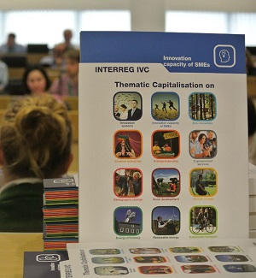
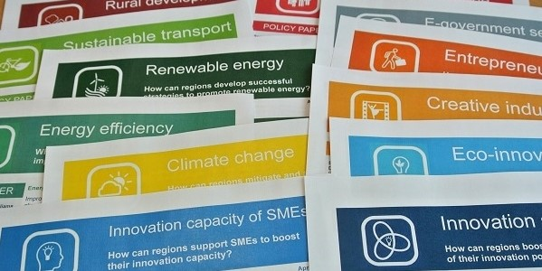
INTERREG IVC
Thematic programme capitalisation
12 sets of reports, brochures & policy papers
All available at:
www.interreg4c.eu/capitalisation/

Slide 7

INTERREG IVC
And what about
Belgium in INTERREG IVC?

Slide 8
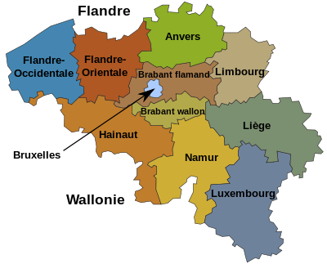
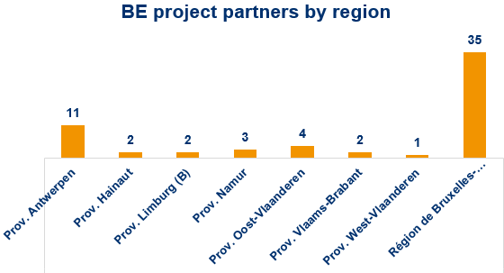
Belgium in INTERREG IVC
11.1 m
inhabitants
2.15 %
IVC population
257 partners
in 200 project applications
18 BE-led applications
17% approved
(vs. 15% prog. average)
50 projects = 61 partners, 3 Lead partners
23.5 % of total projects

Slide 9
Belgium in INTERREG IVC
Main achievements in Belgium (2014)
7 Provinces & Brussels Region involved
198
staff with increased capacity
Objective:
EU wide exchange of experience / capacity building
3
‘spin-off activities’
Objective:
Identification / sharing / transfer of good practices
6
practices transferred
Objective:
Improvement of regional and local policies
6
policies improved

Slide 10

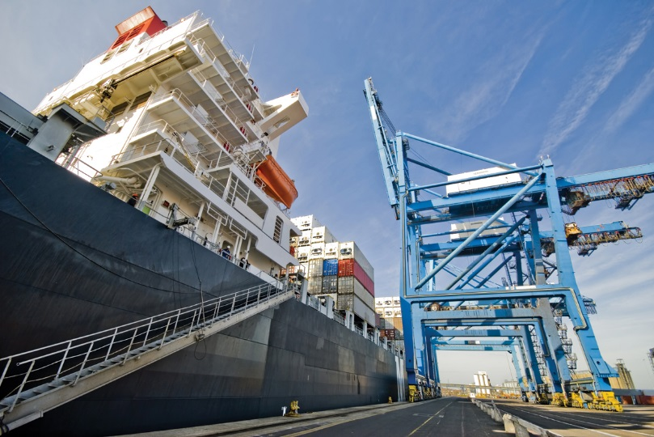
Belgium in INTERREG IVC
Example of transfer
Project:
Practice:
The practice “Environmental Ship Index” is designed to improve the environmental performance of boats. This index evaluates the ships performance regarding air pollutants, CO2 and is automatically updated.
From: Hamburg Port Authority (DE)
To: Antwerp Port Authority (BE)

Slide 11

Belgium in INTERREG IVC
Example of policy improvements
Project:
Partner concerned: Flanders District of Creativity (BE)
Policy improved: Flemish Government decision (15/07/2011): launch of a platform for ElectroMobility: "Vlaamse
Proeftuin Elektrische Voertuigen" and "Living Lab
Electrical Vehicles“. 5 projects selected for the
2011-2014 period.

Slide 12

Belgium in INTERREG IVC
Example of policy improvements
Project:
Partner concerned: Province of East Flanders (BE)
Policy improved: CREA.RE action plan approved by the provincial
deputation. It has become the reference
document for all activities supporting creative
industries in the province (e.g. develop a design
platform, collaboration with Chambers of
commerce)

Slide 13
Belgium as a source of inspiration

Slide 14

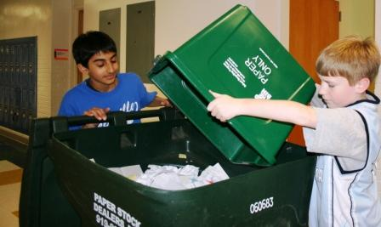

Belgium in INTERREG IVC
Example of transfer
Project:
Practice:
“Let’s do it with Ferda” practice is a set of educational tools used for teaching primary school children how to prevent waste. A mascot has also been created to raise awareness of the children.
From: Brussels Environnement IBGE
To: Ilfov County Council (RO)

Slide 15


Belgium in INTERREG IVC
Example of transfer
Project:
Practice:
The main function of the “Scientific Intermediation Group” practice is to provide a point of contact for companies where they can find solutions for their technology-related questions, find cooperation partners and support in applications for public funding programmes.
From: Economic Office of the Province of Namur (BE)
To: Stuttgart Region Economic Development Corporation (DE)

Slide 16


Slide 17

Thank you for your attention!

